Slide 1
Malignant Comments Classifier
Submitted by : Harshita Panchamia
Batch No : Internship 25

Slide 2
Introduction
The proliferation of social media enables people to express their opinions widely online. However, at the same time, this has resulted in the emergence of conflict and hate, making online environments uninviting for users.
Although researchers have found that hate is a problem across multiple platforms, there is a lack of models for online hate detection.
Online hate, described as abusive language, aggression, cyberbullying, hatefulness and many others has been identified as a major threat on online social media platforms.
Social media platforms are the most prominent grounds for such toxic behaviour.

Slide 3
Introduction
There has been a remarkable increase in the cases of cyberbullying and trolls on various social media platforms.
Many celebrities and influences are facing backlashes from people and have to come across hateful and offensive comments.
This can take a toll on anyone and affect them mentally leading to depression, mental illness, self-hatred and suicidal thoughts

Slide 4
Objective
Internet comments are bastions of hatred and vitriol.
While online anonymity has provided a new outlet for aggression and hate speech, machine learning can be used to fight it.
The problem we sought to solve was the tagging of internet comments that are aggressive towards other users. This means that insults to third parties such as celebrities will be tagged as unoffensive, but “u are an idiot” is clearly offensive.
Our goal is to build a prototype of online hate and abuse comment classifier which can used to classify hate and offensive comments so that it can be controlled and restricted from spreading hatred and cyberbullying.

Slide 5
Technical Requirements
The data set contains the training set, which has approximately 1,59,000 samples and the test set which contains nearly 1,53,000 samples.
Perform proper data cleaning and text exploration.
To infer unique patterns from the data and try to generate new features.
Using 4-5 models for training to do proper hyperparameter tuning and choose the right evaluation metrics to finalizing the model.
Testing predictions on multiple metrics like log loss, Recall and Precision.

Slide 6
Dataset Description
The data set contains the training set, which has approximately 1,59,000 samples and the test set which contains nearly 1,53,000 samples.
All the data samples contain 8 fields which includes ‘Id’, ‘Comments’, ‘Malignant’, ‘Highly malignant’, ‘Rude’, ‘Threat’, ‘Abuse’ and ‘Loathe’.
There are various comments which have multiple labels.
The first attribute is a unique ID associated with each comment.

Slide 7
Dataset Description
The label can be either 0 or 1, where 0 denotes a NO while 1 denotes a YES.
The data set includes:
id : person who have written the comment is generalised by id.
comment_text : thoughts of person.
malignant : binary label which contains 0/1.
highly-malignant: binary label which contains 0/1.
rude: binary label which contains 0/1.
loathe: binary label which contains 0/1.
abuse : binary label which contains 0/1.
threat : binary label which contains 0/1.

Slide 8
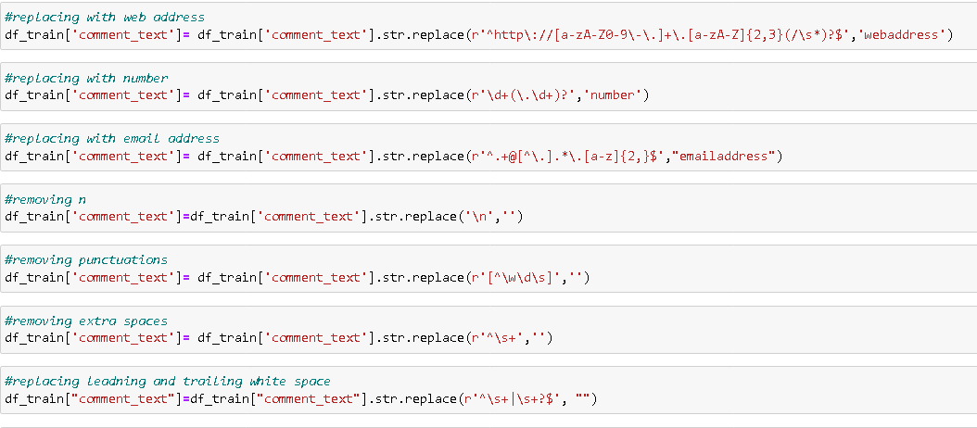
Data pre-processing
Converting lower case to upper case:
Text normalisation: it includes removing punctuation and symbols.

Slide 9


Stop words & lemmatisation
Stop words : Stop words are those words that are frequently used in both written and verbal communication and thereby do not have either a positive/negative impact on our statement.
Lemmatisation: lemmatisation is the process of grouping together of different inflated form words so they can be analysed as a single item.

Slide 10
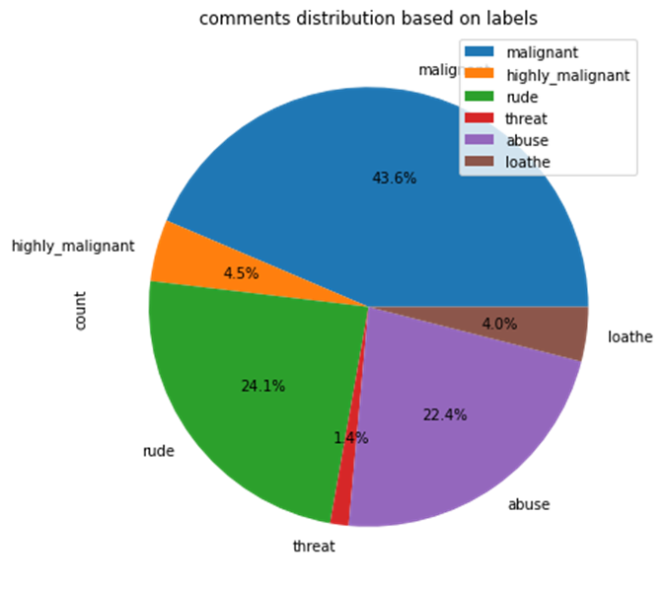
Data Visualizations
According to the data, malignant comments has highest percentage of 43.6% followed by rude 24.1%, abuse 22.4%, highly malignant 4.5%, loathe 4% and threat 1.4% .

Slide 11
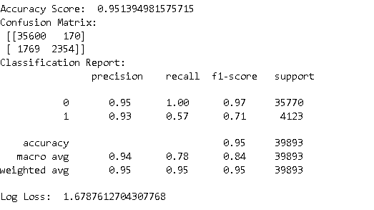
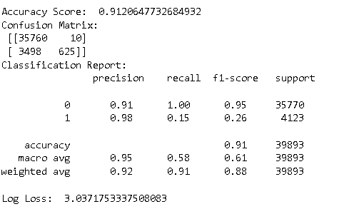
Model Building
1. Logistic Regression
2. MultinomialNB

Slide 12
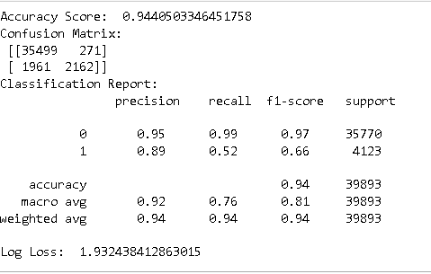
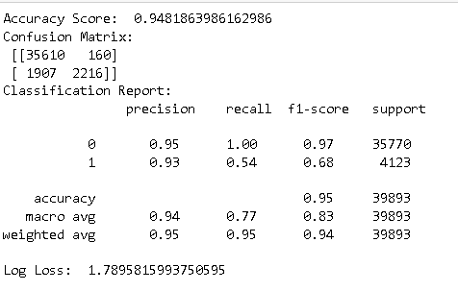
Model Building
3. AdaBoost Classifier
4. Random Forest Classifier

Slide 13
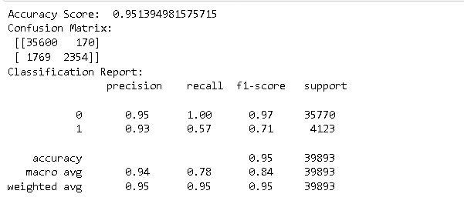
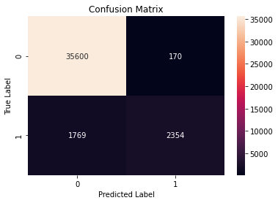
Hyper parameter tunning
The best model among all the 4 models is Logistic Regression, so we will hypertune it for better results

Slide 14
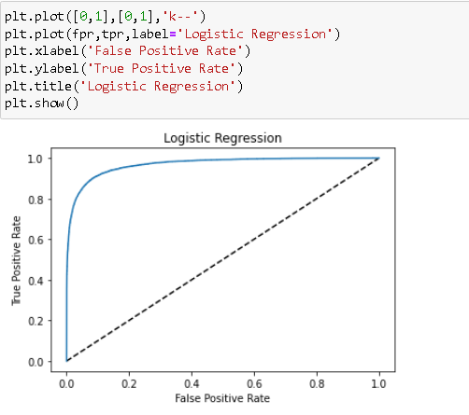
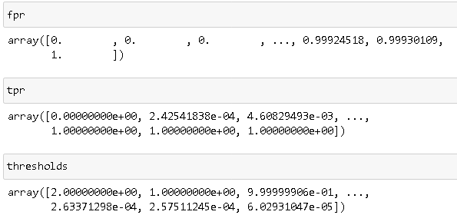
AUC ROC Curve
AUC ROC Curve is a performance for classification problems at various threshold settings.
The ROC curve is plotted with TPR against the Fpr where TPR is plotted on the y-axis and FPR is plotted on x-axis.

Slide 15
Conclusion
This research work focuses on developing a model that would automatically classify a comment as either malignant or non-malignant using logistic regression.
Therefore, this study aims to develop a multi-headed model to detect different types of malignant comment like threats, rude, abusive, and loathe.
By collecting and pre-processing malignant comments for training and testing using term frequency- inverse document frequency (TF-IDF) algorithm, developing a multi-headed model will detect different types of malignant comment using logistic regression to train the dataset, and evaluate the model using confusion metrics.

